Slide 1

Stellar Profiles of Massive Galaxies: Hyper Suprime-Cam Survey vs. Hydrodynamic Simulations
Felipe Ardila¹
Alexie Leauthaud¹, Song Huang¹,
Benedikt Diemer², Annalisa Pillepich³
¹ UC Santa Cruz, ²CfA, ³MPIA

Slide 2
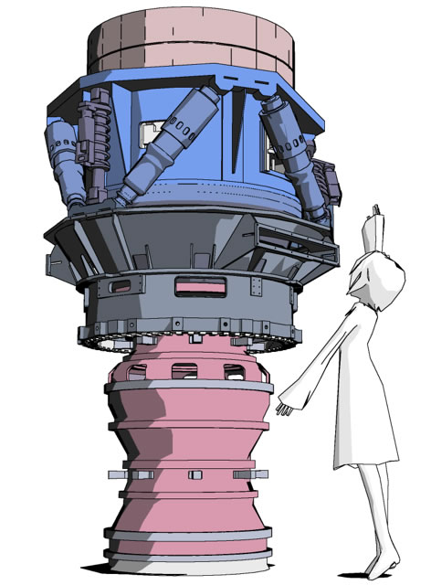
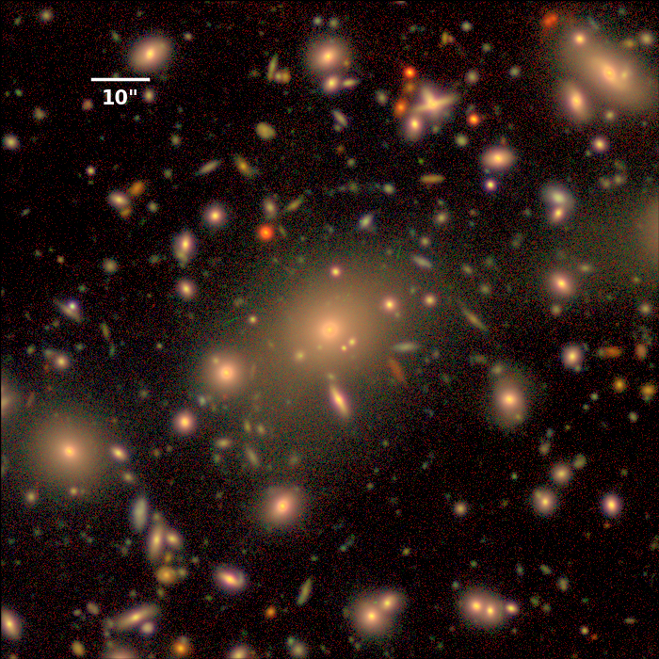
Hyper Suprime-Cam (HSC)

Slide 3
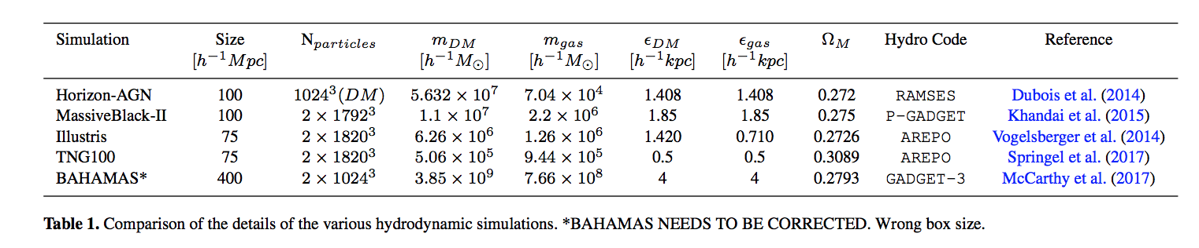
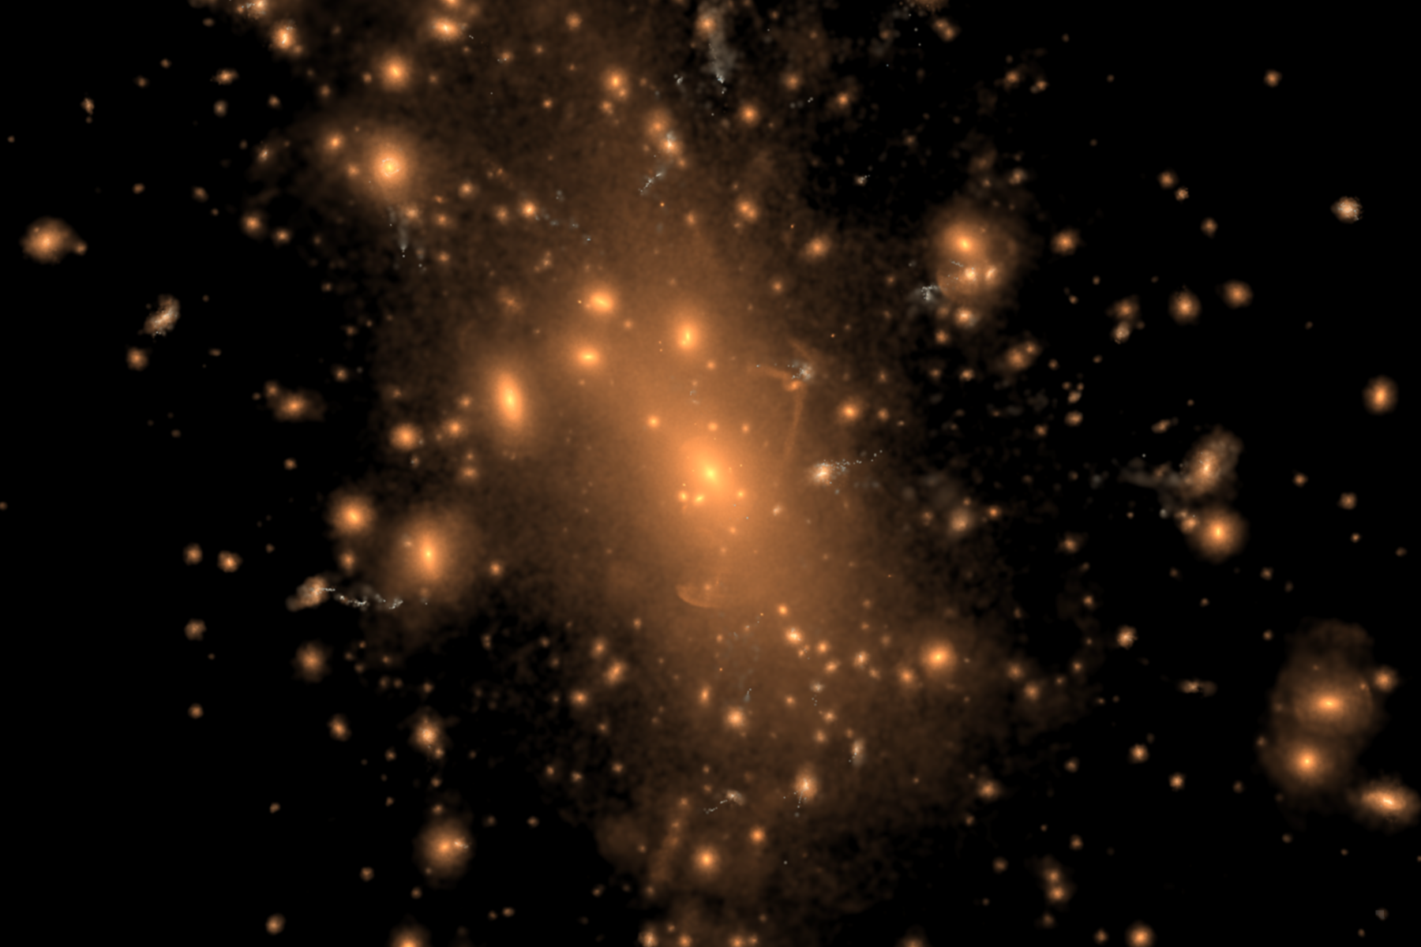

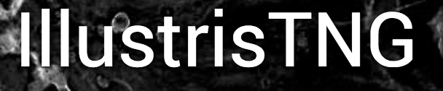
Hydrodynamic Simulations
Notes:
Stellar light distribution (rest-frame B,g,r band composites) of the most massive cluster in the simulation volume, at z=0.

Slide 4
Matched by M★^{1d, 100}

Slide 5
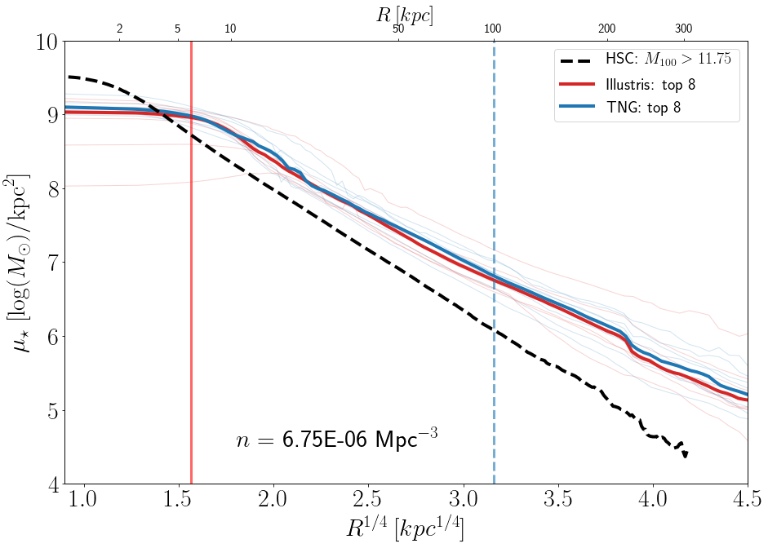
Matched by number density

Slide 6
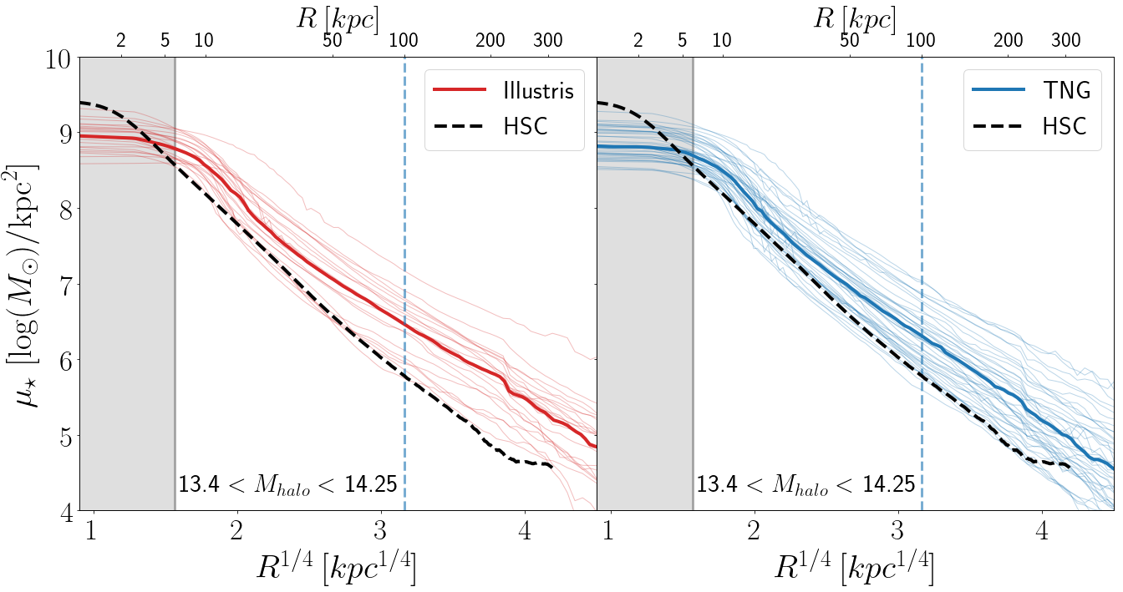
Matched by M_{halo}

Slide 7
Stellar Mass Functions

Slide 8
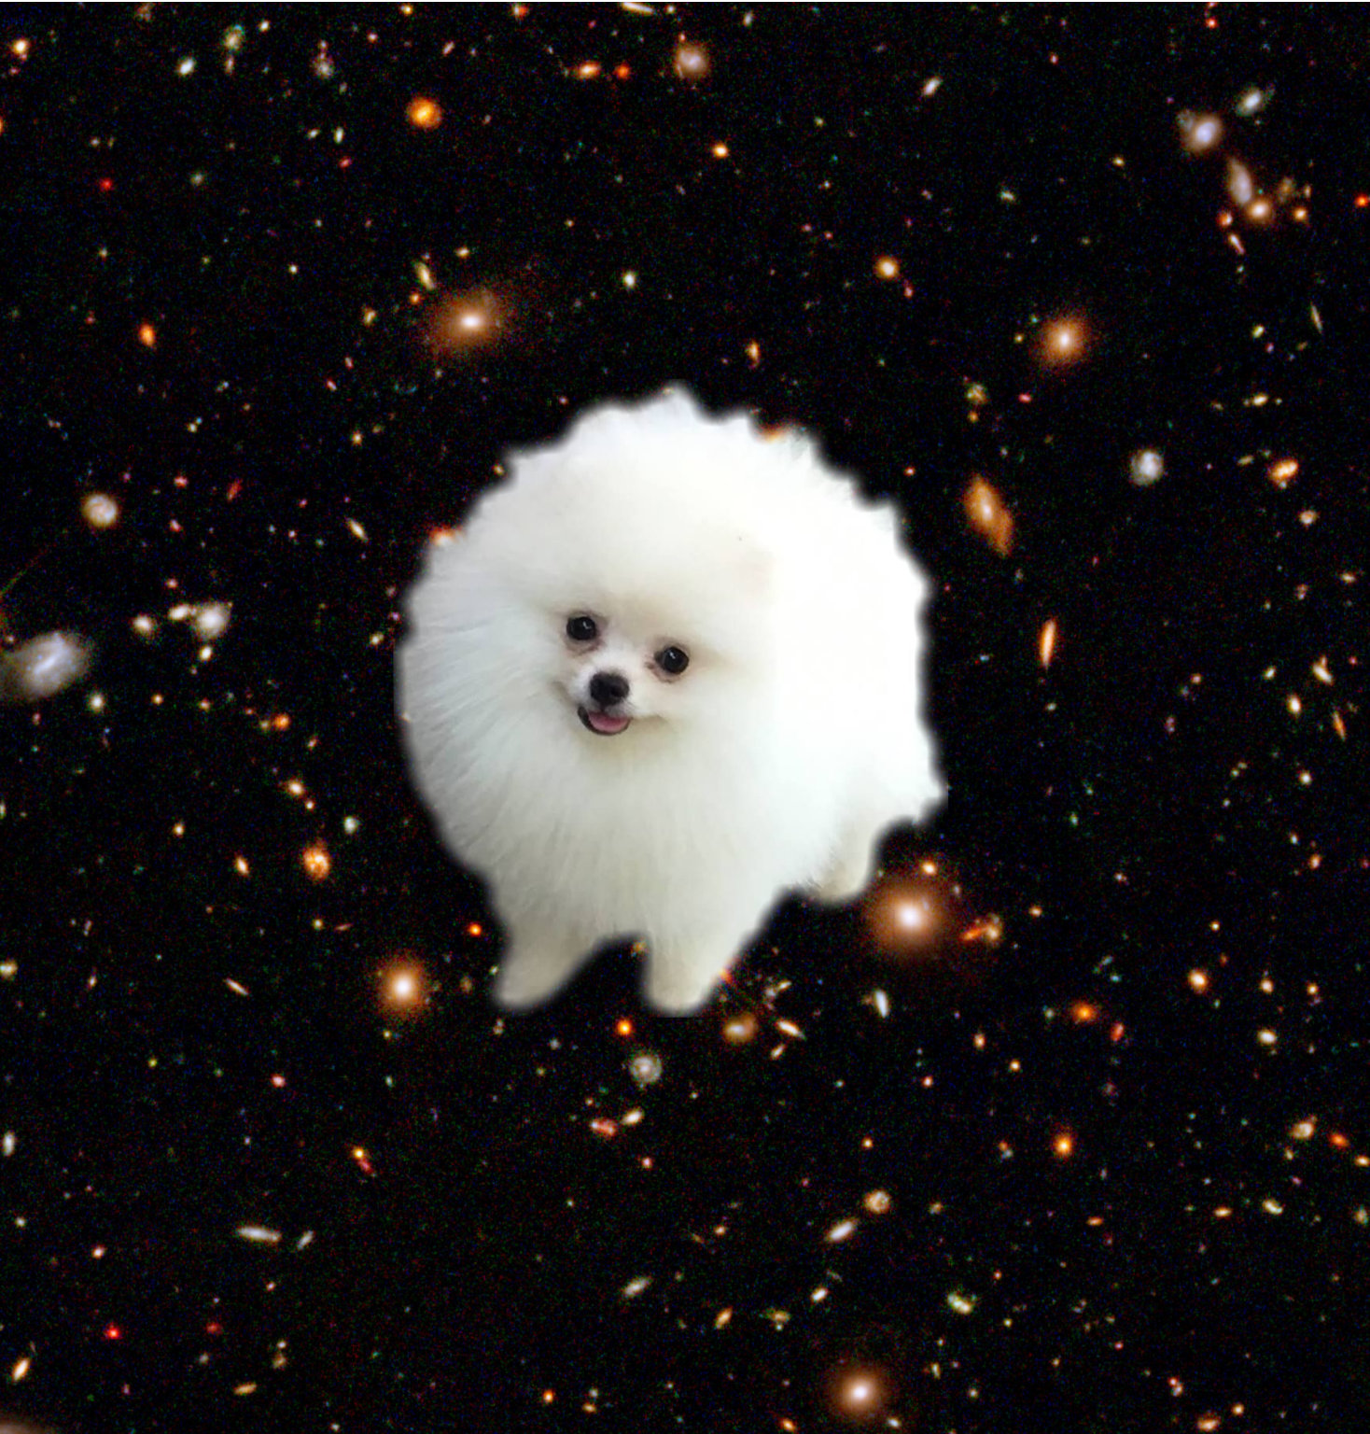
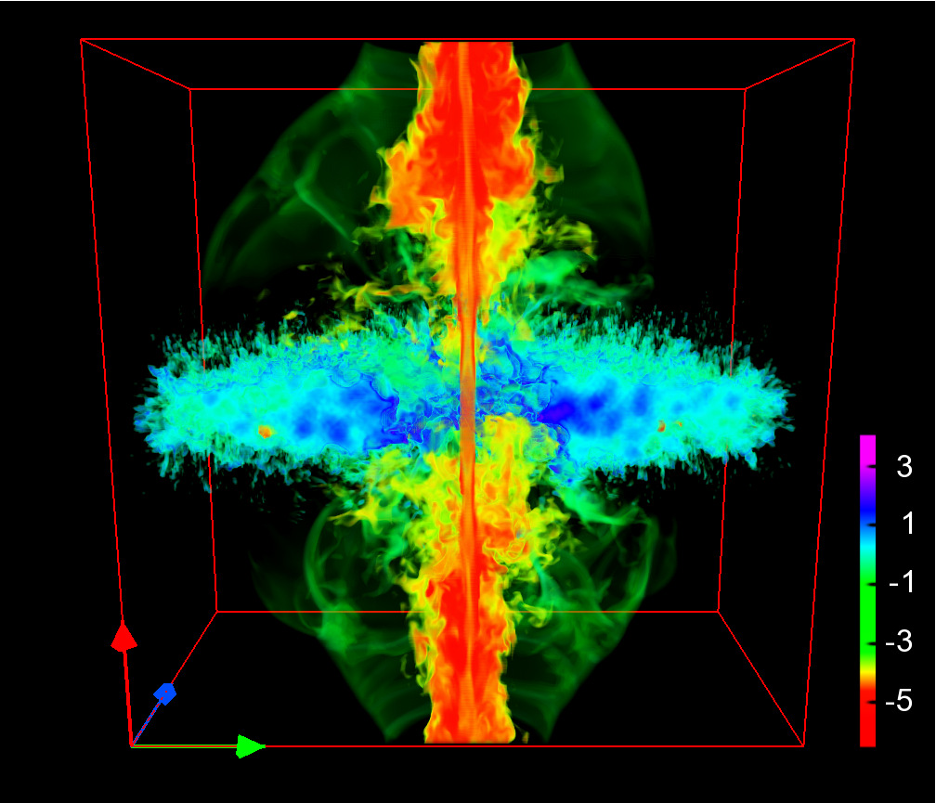
Main Takeaways:
Illustris and TNG galaxies still too puffy
Need to calibrate AGN feedback and baryonic effects differently
Notes:
https://nl.pinterest.com/pin/514465957424466757/
http://inspirehep.net/record/1122490/plots

